Slide 1









USER GENERATED CONTENT ANALYTICS Fall 2018 Sessions 3 & 4, 09/06, 09/11
Dr. Anitesh Barua
David Bruton Jr. Centennial Chair Professor of Business
Distinguished Fellow, INFORMS Information Systems Society
Stevens Piper Foundation Professor
University of Texas Distinguished Teaching Professor
Associate Director, Center for Research in e-Commerce
McCombs School of Business, University of Texas at Austin
Email: aniteshb@gmail.com

Slide 2
Knowledge Discovery & Insights from User Generated Content
User generated content (UGC) can reveal new insights about brands, products & events
The idea
Find out what people are talking about
Find key entities (e.g., brands, products, etc.) & attributes (e.g., service, price, etc.)
Find associations between words
For now, we’ll do it manually; but can be automated
Copyright Anitesh Barua 2018

Slide 3

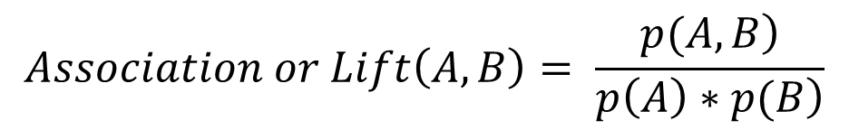
Co-occurrence of Terms
Do terms or words appear together in messages by chance or due to real association?
E.g., is Volvo more likely to mentioned in conjunction with safety related words than Toyota?
Is Honda more likely to be associated with reliability than, say, Jaguar?
$$Let A and B represent two words or phrases$$
$$E.g., A=Volvo, B=safety$$
$$Association or Lift\left(A,B\right)= \frac{\left.p(A,B\right)}{\left.p\left(A\right)∗p(B\right)}$$
$$where p\left(A,B\right) is the probability of both A \& B appearing in a message$$
$$where p\left(A\right) is the probability of A appearing in a message$$
$$where p\left(B\right) is the probability of B appearing in a message$$

Slide 4
Interpretation of Lift
Lift can be = 1, > 1 or < 1
What does it mean when Lift(A,B) = 1?
It means A & B are not associated in the minds of the crowd, and that any co-mentions of A & B are due to chance only
Why so?
For two events a and b, $p\left(a,b\right)=p\left(a\right)∗p(b)$ when a and b are independent
What about Lift (A,B) > 1?
What is the significance of the word Lift in this context?
What about Lift(A,B) < 1?
From a practical standpoint we don’t distinguish between Lift(A,B) = 1 or < 1

Slide 5
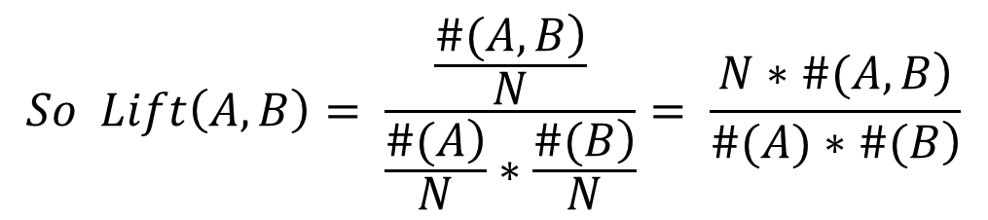
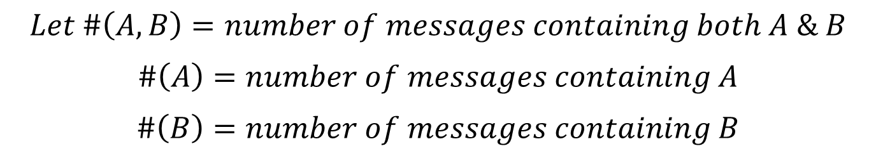
An Frequentist Interpretation of Lift
$$Let \#\left(A,B\right)=number of messages containing both A \& B$$
$$\#\left(A\right)=number of messages containing A$$
$$\#\left(B\right)=number of messages containing B$$
$$Then p\left(A,B\right)=\frac{\left.\#(A,B\right)}{N}, p\left(A\right)= \frac{\left.\#(A\right)}{N}, p\left(B\right)= \frac{\left.\#(B\right)}{N}$$
$$So Lift\left(A,B\right)= \frac{\frac{\left.\#(A,B\right)}{N}}{\frac{\left.\#(A\right)}{N}∗\frac{\left.\#(B\right)}{N}}= \frac{\left.N∗\#(A,B\right)}{\left.\#(A)∗\#(B\right)}$$
Does this mean that lift will increase with sample size?

Slide 6
An Example from Edmunds.com
 | Toyota Camry | Volvo S40
# mentions | 34,559 | 1160
# co-mentions with safety related words | 379 | 60
Lift of make/model & safety related words
Total # messages: 868,174 (assume one make/model
appears only once in a message
Safety related messages: 4534
What are the values of Lift(Volvo, safety) and Lift(Toyota, safety)?

Slide 7














Which Associations are Strong?
?
Copyright Anitesh Barua 2018

Slide 8
How is Lift Different from Confidence?
Commonly found in commercial software packages
n% of people who mentioned word x (e.g., BMW) also mentioned y (e.g., Lexus)
Confidence(Lexus|BMW) = #(Lexus,BMW)/#(BMW) = (say) 125 / 300 = .417
Confidence is not symmetric
Confidence(Lexus|BMW) may be very different from Confidence(BMW|Lexus)
Also if most people talk about Lexus anyway, Confidence(Lexus|BMW) is not a useful metric.
Copyright Anitesh Barua 2018

Slide 9
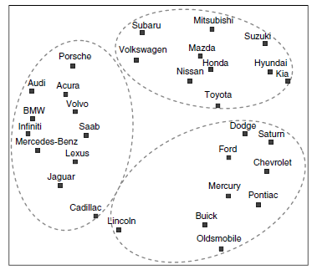
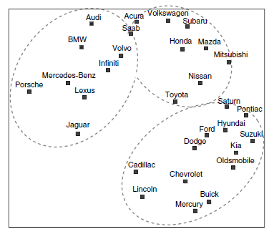
Can We Predict Switching Behavior?
Forum co-mentions
(100k mentions)
Actual brand switching
(3.5 million)

Slide 10
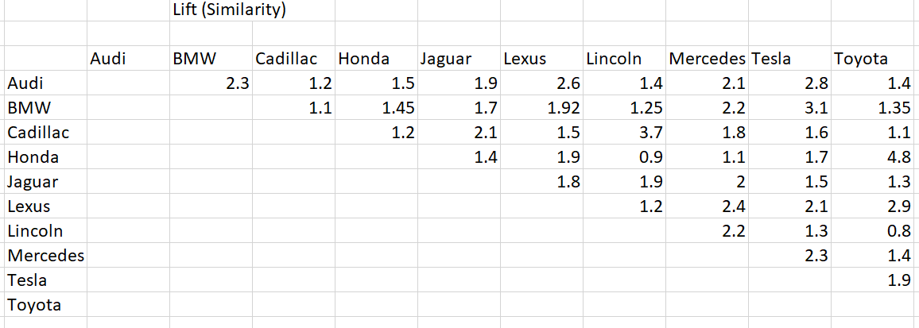
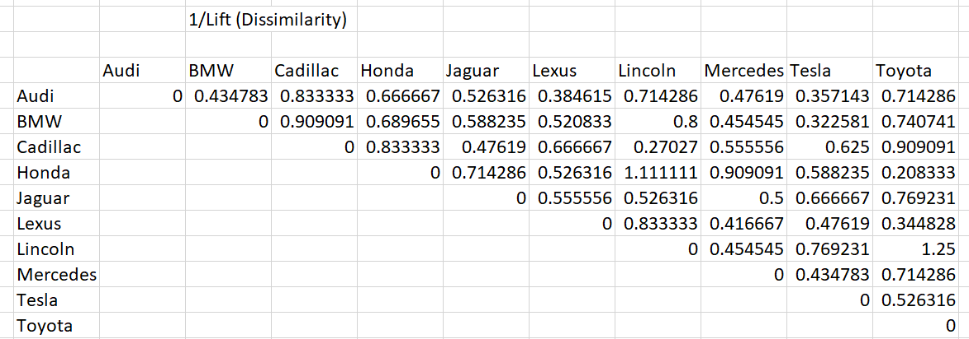
How to Draw an MDS Plot
Should we plot the lift values directly?
Copyright Anitesh Barua 2018

Slide 11
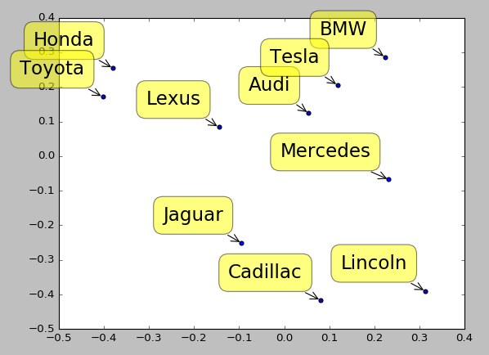
What do the MDS Axes Represent?
Coordinates for each brand
What does the distance between a pair of brands represent?
Copyright Anitesh Barua 2018

Slide 12
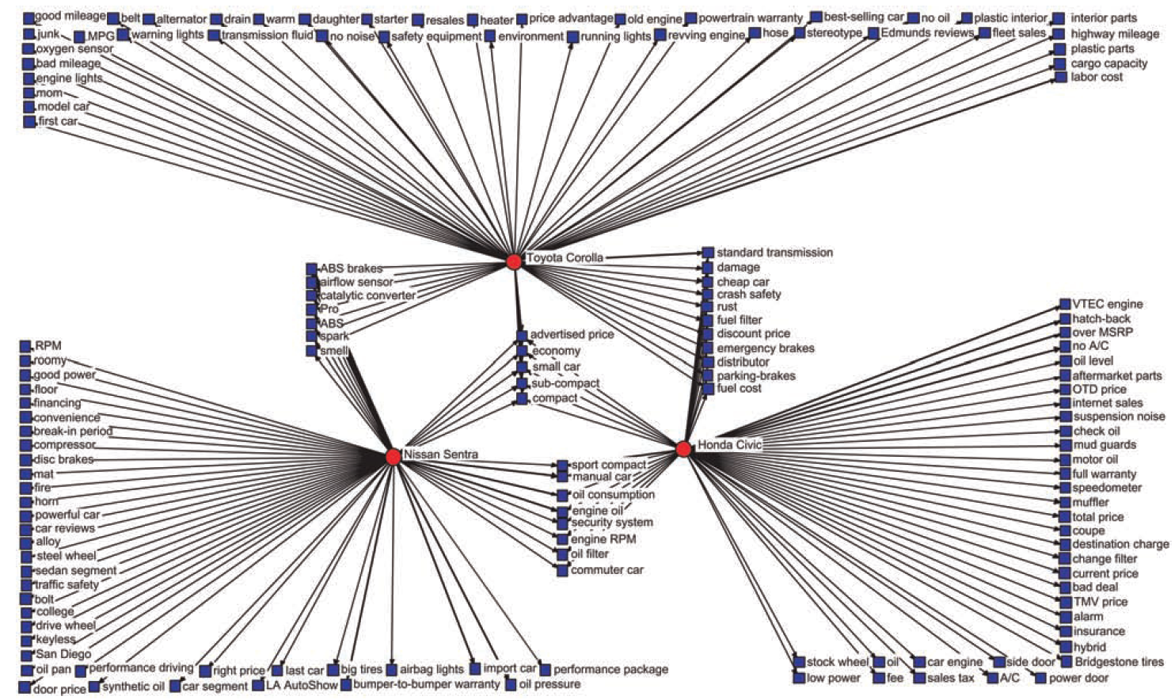
Product Attribute Associations

Slide 13
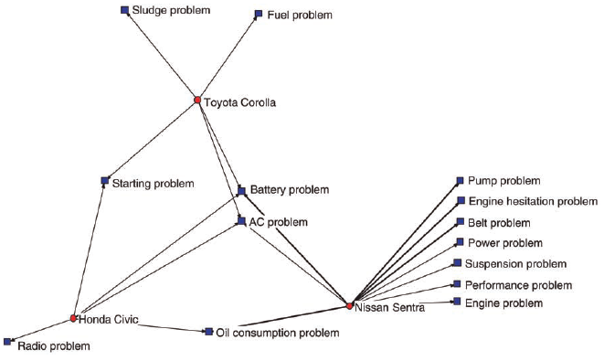
Negative Perceptions

Slide 14
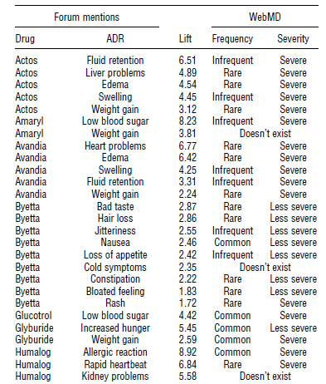
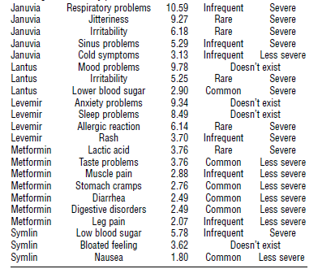
Crowds Vs. Experts

